Slide 1


Water Potability
Jacob l. Vaughn

Slide 2
Water Potability with Machine Learning
Dataset provides water properties that are measured for the potability of water
Using machine learning, the goal is to predict a water’s potability using recorded property values
Two models were applied, adjusted, and tested using the dataset
Notes:
Dataset provides water properties that are measured to determine water’s potability. The dataset contains nine features, pH, Hardness, Solids, Chloramines, Sulfate, Conductivity, Organic Carbon, Trihalomethanes, and Turbidity. Each of these contains a value that impacts potability. Using this dataset, the goal is to apply machine learning to predict a water’s potability with recorded property values. To achieve this, two models were applied, adjusted, and tested with the nine features.

Slide 3
Visualize Water Potability Features
Visuals assist in better understanding the correlation between features
Provides a clear understanding of feature importance
A glimpse at possible outlier values
Compare and evaluate two graphs simultaneously
Identify potential difficulties in applying a Machine Learning Model
Notes:
To gain an understanding of the data, visuals displaying water potability features were developed. These visuals assist in better understanding the correlation between features, provides a clear understanding of feature importance, a glimpse at potential outlier values, compare and evaluate two graphs simultaneously, and identify possible difficulties in applying a machine learning model.

Slide 4
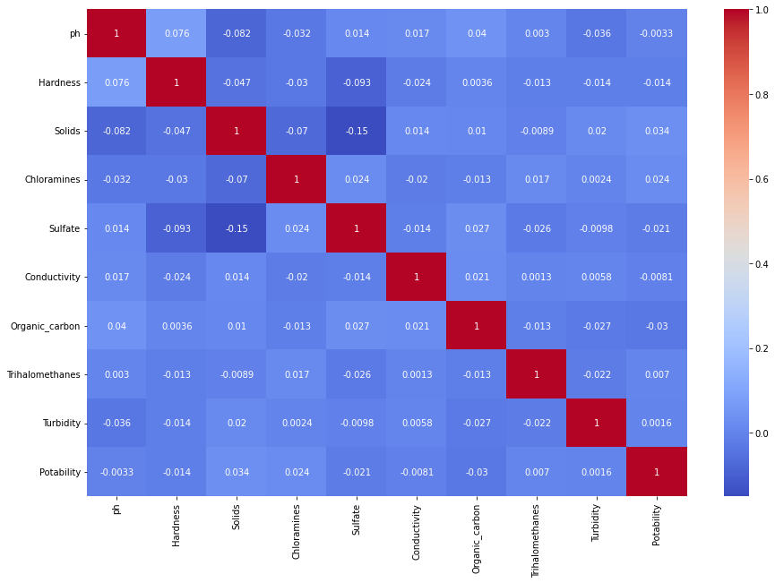
Correlation Heatmap
Map shows how correlated water properties are with one another
The darker blue, the less correlated
Lighter blue is more correlated
Dark red is highly correlated
Notes:
The correlation heatmap displays how correlated water properties are with one another. The darker blue, the less correlated, the lighter blue is more correlated, and dark red is highly correlated.

Slide 5
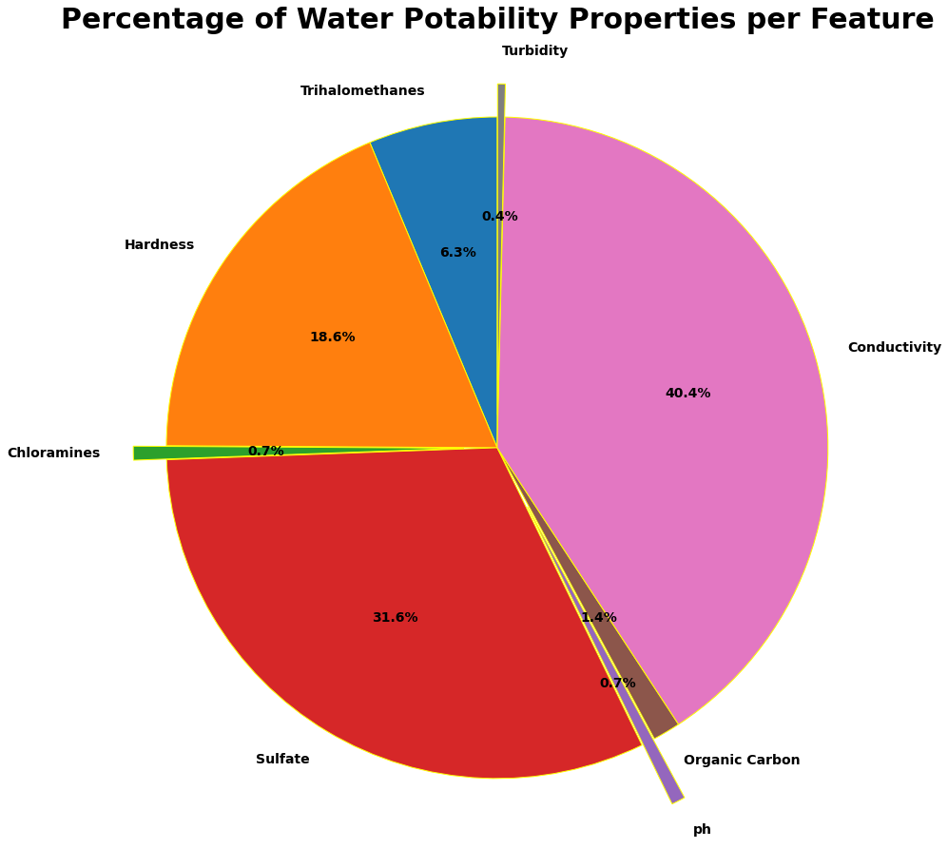
Water Potability Pie Chart
Total water potability percentages provides an understanding of property importance
Sulfate, hardness, and conductivity determines over 90% of water’s potability
The other properties do not carry the same amount of weight in terms of potability
Notes:
This water potability pie chart displays water potability percentages, per feature, to gain an understanding of property importance. Note that solids are not graphed because it held too large a percentage. If graphed, it would dominate the chart and not allow for the weights of other properties to be easily viewed. In this chart, Sulfate, hardness, and conductivity determines over 90% of water’s potability, while other properties do not appear to carry the same weight.

Slide 6
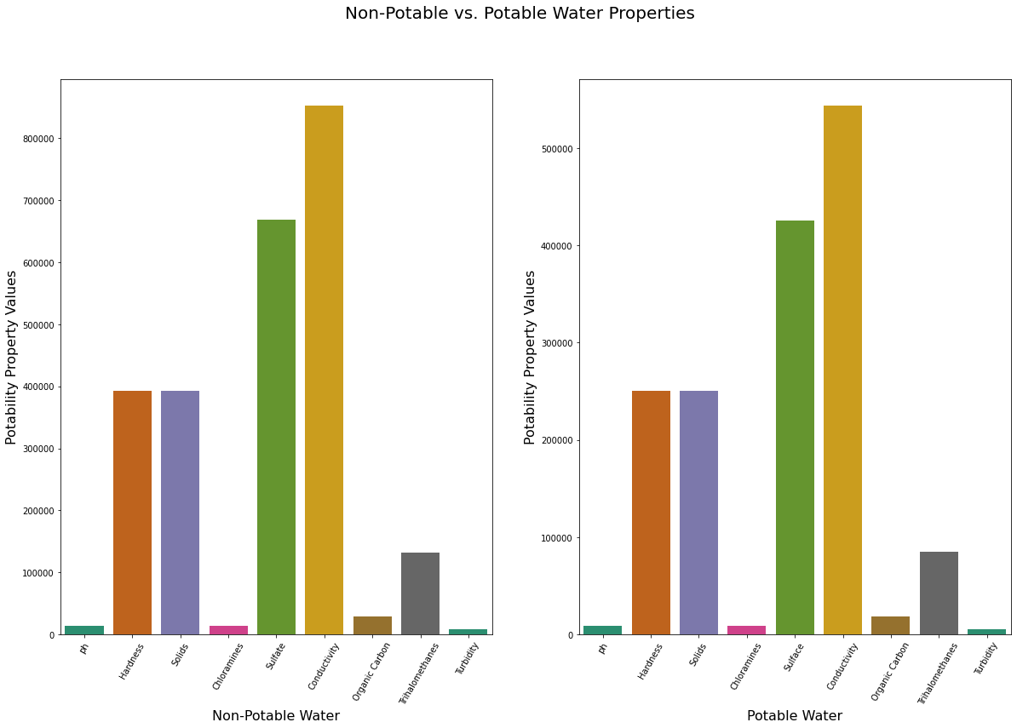
Bar Graph
Comparison of Non-Potable Water properties against Potable Water properties
Non-potable has a value range of 100,000 to a little over 800,000
Potable has a value range from 100,00 to a bit over 500,000
Lower water property values are required for water to be considered potable
Notes:
This side-by-side bar chart allows us to view the differences among feature values between non-potable and potable water. On initial inspection, the graphs look identical, however, the potability property values have differing ranges. Non-potable has a value range of 100,000 to a little over 800,000 and potable’s range is 100,000 to a bit over 500,000. This comparison bar graph shows that lower water property values are required for water to be considered potable.

Slide 7
Production Model
Used Random Forest Classifier Model
Randomly selects a subset of features for each split/tree
Decorrelates trees, resulting in reducing variance
Variance is the variability in the model predicting
Random Forest Classifier Metrics
Accuracy
Number of True Positives plus True Negatives divided by All Cases
Recall
Number of True Positives divided by the sum of True Positives and False Negatives
Precision
Number of True Positives divided by the sum of True Positives and False Positives
Notes:
The production model used was a Random Forest Classifier Model. This model selects a subset of features for each split/tree. This model decorrelates trees, which results in reducing model variance. Variance is the variability in the model predicting. To assess the model’s performance, the metrics accuracy, recall, and precision were evaluated. Accuracy refers to the number of predictions calculated as true positives plus true negatives divided by all cases (TP, TN, FP, FN). Recall is determined by dividing true positives by the sum of true positives and false negatives. Precision is equal to true positives divided by the sum of true positives and false negatives.

Slide 8
Production Model (cont.)
Base/default model used initially
Scores (ability to predict water potability)
Accuracy: 67.6%
Recall: 67.6%
Precision: 66.6%
Tuned model to use best parameters
Parameters
Variables and thresholds used to split each prediction during training
Accuracy: 68.3%
Recall: 68.3%
Precision: 67.7%

Slide 9
Final Recommendations
It is suggested that features be split into two groups to be tested
The two groups can be determined with feature likeness and/or feature weight
Possible grouping of sulfate, conductivity, hardness, and solids
To further test water’s potability
Create test environments for water to determine the base threshold for each feature in terms of potability
Apply a more advanced learning model
It would be advantageous for a more advanced learning model to be applied
This would possibly reduce variance and biases, allowing a stronger prediction
Notes:
It is recommended that features be split, and tested, into two groups. The two groups could be determined with feature likeness and/or feature weight. For example, sulfate, conductivity, hardness, and solids could be grouped together due to their overall feature importance, which was noted in the pie chart. Further testing water’s potability in controlled environments could assist in determining overall potability. These test environments for water might allow for a threshold/baseline for each feature to be determined regarding potability. In turn, these could be used to eliminate future feature values as non-potable. Lastly, a more advanced learning model should be used. It would be advantageous for a more advanced learning model to be applied to reduce variance and biases, allowing a stronger, more accurate, water potability prediction.

